Slide 1
Ukrainian banking: refreshed and efficient, but vulnerable to political risks
Dmytro Sologub
Deputy Governor
Berlin, June 2019

Slide 2
Where we are
The next IMF tranche has been postponed until the parliamentary elections and formation of a new government.
Macroeconomic policy remains sound.
No disruptive issues with banking system.
Mild deterioration of FX and business expectations.
A key assumption of the macroeconomic and financial sector forecast is that Ukraine will continue to cooperate with the IMF, which will allow to attract other official financing, improve access to the international capital markets and support interest of nonresidents in UAH-denominated bonds.

Slide 3
Key risks
More uncertainty due to early parliament election
External risks ( global recession, decline in commodity prices)
Uncertainty over the volume of gas transit through Ukraine in 2020
Escalation of the military conflict and new trade restrictions by RF
Risks to Ukraine's financial stability and the NBU’s independence

Slide 4
Macroeconomic recovery is underway
Contributions to Real GDP Growth, pp
Headline CPI, %
Source: SSSU, NBU staff estimates.
Source: SSSU, NBU staff estimates.
Macroeconomic stability has been entrenched amid steady growth recovery and decelerating inflation
GDP growth slows down to 2.5% in 2019 but will accelerate in the coming years.
Inflation will go down to 6.3% this year and will hit the target in 2020.

Slide 5
We don’t expect capital outflows, though planned public external debt repayments are challenging
Public External Debt Repayments*, USD bn
Financial Account (FA): Net Inflows, USD bn
* As of April 16, 2019
Source: IMF, С-bonds, NBU, Inflation Report April 2019
Source: NBU, Inflation Report April 2019.
Stable macroeconomic situation allows NBU to ease FX regulations without negative consequences for capital flows. Connection to ClearStream system launched in 2019.
In 2019-2021 due repayments on sovereign debt should exceed to USD 20 bn USD.
Cooperation with IMF and other IFI’s is vital to assure smooth fulfillment of government obligations. Our baseline scenario implies that cooperation continues.

Slide 6
Key macroeconomic indicators
 | 2018 | 2019 | 2020 | 2021
Real GDP, change, % | 3.3 | 2.5 | 2.9 | 3.7
Nominal GDP, UAH bn | 3 559 | 3 970 | 4 342 | 4 750
CPI, y-o-y, % | 9.8 | 6.3 | 5.0 | 5.0
Core CPI, y-o-y, % | 8.7 | 5.0 | 3.7 | 3.7
Current account balance, USD bn | -4.5 | -4.9 | -5.8 | -6.7
% GDP | -3.4 | -3.3 | -3.6 | -4.0
BOP (overall), USD bn | 2.9 | -0.3 | -0.1 | -0.7
Gross reserves, USD bn | 20.8 | 21.2 | 21.9 | 21.8
Source: Inflation Report, April 2019

Slide 7
The NBU is moving towards a currency liberalization
Meeting appropriate macro- conditions
STAGES
BEPS principles implementation
LIFTING TEMPORARY
ADMINISTRATIVE
RESTRICTIONS
STAGE 0: CURRENT ACCOUNT AND FDI
STAGE1: PORTFOLIO INVESTMENTS AND CREDIT OPERATIONS OF CORPORATES
STAGE2: FINANCIAL OPERATIONS OF individuals
TARGET
TODAY
Stimulation of economic growth and productivity
FX market
and financial system development to support economic growth
Widening funding opportunities and resident’s
investments
for assets diversification
Free capital movement
  Transition to the next stage of currency liberalization can be done in case of implementation of OECD recommendations to BEPS resistance and unified standard of automatic exchange of financial information

Slide 8
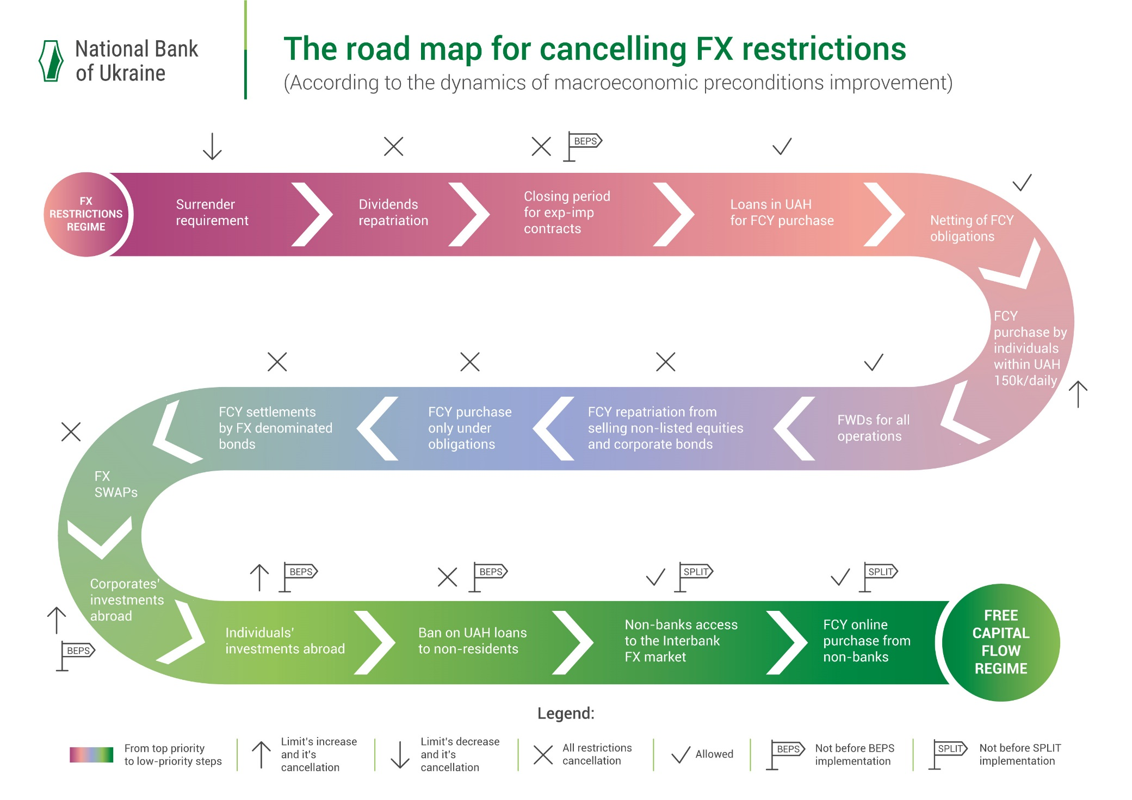
ЗУ «Про валюту і валютні операції» та нові НПА
9

Slide 9
Facing the perfect storm, the National Bank of Ukraine launched a comprehensive reform of the local banking industry
Insolvent banks withdrawn from the market
Banks recapitalized following AQR and stress-tests
AML rules and procedures overhauled
Real UBOs disclosed for all banks
Unwinding of related-party lending launched
Clean-up
Reload
Business strategy overhaul and management enhancement at state-owned banks
Resumption of full-fledged lending by banks
Banking sector consolidation
Enhancing NPL resolution mechanism
Enhanced information disclosure standards
Sustainable development
Harmonization of banking regulations with Basel recommendations and EU Directives
Implementation of effective risk-based banking supervision approach consistent with SREP
Enhancement of creditor rights protection
Implementing IFRS 9
2015
2016
2017
2018
2020
Today
  In addition to the overhaul of the banking system, the NBU simultaneously launched a radical internal transformation

Slide 10
Run on banks ends off, the banking system is stable though still dominated by state-owned banks
Banks’ total assets by groups, UAH billion
Number of banks
 | 2015 | 2016 | 2017 | 2018 | May-19
Solvent | 117 | 96 | 82 | 77 | 76
- change | -30 | -21 | -14 | -4 | 0
State-owned | 7 | 6 | 5 | 5 | 5
- change | 0 | -1 | -1 | 0 | 0
Foreign | 25 | 25 | 23 | 21 | 21
- change | 0 | 0 | -2 | -2 | 0
Private | 85 | 65 | 54 | 51 | 51
- change | -30 | -20 | -11 | -2 | 0
Insolvent | 3 | 4 | 2 | 1 | 1
- change | -13 | 1 | -2 | 0 | 0
Source: NBU.
Solvent banks were grouped under the relevant classification for the given years. Figures - number of banks in each group.
Source: NBU.
76 banks operate in the market as of the beginning of June.
No new bank bankruptcies over last 1.5 years – a smaller number of banks results form M&A and banks’ reorganizations into financial companies.
At present, state-owned banks dominate the market – the issue which Ukraine started to resolve in 2018. Government has adopted The Strategy for SOBs, which aims at privatization of state-owned banks. New supervisory boards with independent Directors were appointed, which will lead to corporate governance improvement.

Slide 11
The banking system is solvent and profitable
Regulatory capital and regulatory capital adequacy
Banking system net profit, UAH billion
Source: NBU.
Source: NBU.
Capital adequacy ratios are well above the minimum required level (10% for T1).
Banking system returned to profitability in 2018, driven mostly by state-owned PrivatBank, while almost all large and medium-sized banks also reported solid financials (only 13 out of 76 banks reported net losses in 2018).
In 2019, the trend continues, net profit for the banking system grew up 1.5x yoy, driven by both interest and commission income growth, LLPs rates are record low (cost of risk less than 2%).

Slide 12
Both loans and deposits are growing, mostly UAH-denominated
Deposit Developments, 12.2016=100
Loan Developments, 12.2016=100
Source: NBU.
Source: NBU.
Strong increase in nominal wages, high interest rates on the back of hryvnia appreciation and improved inflation expectations contributed to the inflow of households' UAH deposits.
Consumer loans have been growing fast. Loans to high-quality borrowers with no record of loan default in 2014–2018 continued to grow by more that 25% yoy in 2018. However, high share of NPLs still restrains corporate loans growth.

Slide 13
The NPL ratio is still high, but shows a solid downward trend
NPL portfolio ratio
NPL portfolio depending on the ownership of the banks
Source: NBU
Source: NBU
The big share of NPLs is mainly caused by PrivatBank legacy portfolio – the companies related to its former shareholders, which stopped to serve their loans shortly after the bank was nationalized in late-2016.
The rest of SOBs actively used restructuring tools in 2018. Hope, in 2019 this will be reflected in their statement and results.
For private and foreign-owned banks NPL level is moderate and tends to decrease.

Slide 14
Key domestic challenges for the banking system
Dominance of state-owned banks
Still high volumes of NPLs
Maturity mismatches between funding and lending –
prevalence of short-term funding
High share of FX-denominated loans and deposits
National bank of Ukraine has full capability and competence to properly address these challenges.

Slide 15
Key external threats are political uncertainty and politicians’ attempts to interfere with the NBU’s activities
Termination of cooperation with IMF
Political turbulence
Attack on NBU independence
PrivatBank case
Weakness of judicial system
Political uncertainty has already resulted in postponement of the next IMF tranche until parliamentary elections and formation of a new government.
Cooperation with the IMF is crucial for successful repayment of external public debt – the recent postponement increases the risk of potential fiscal dominance.
Some recent decisions of Ukrainian courts bear risks to NBU independence and Ukraine’s macroeconomic stability.
Ukraine’s key partners, including G-7 and leading IFIs have already confirmed they support the NBU’s actions and see the NBU’s independence as a key factor for financial and macroeconomic stability.
The turbulence rises. Safeguarding Ukrainian financial reforms is a duty of all stakeholders. We have to stand together to assure continuation of this path.

