Slide 1
SERVICING OF CORPORATES IN UKRAINE BY RAIFFEISEN BANK AVAL: CURRENT STATUS AND DEVELOPMENTS
GERMAN-UKRAINIAN FORUM
BERLIN - 2019

Slide 2
Overview of Ukrainian Banking Sector
77 operating banks (down from 86 in 2017 and 186 banks in 2016)
21 banks with foreign capital
5 state owned banks having almost 55% of total assets
Very fragmented banking system (no private bank with more than 5 % market share in assets)
In 2018 banks earned UAH 21.7 bln in net profit (vs net loss UAH 25 bln in 2017)
In 2018 Ukraine’s banking sector has been profitable since 2014

Slide 3
Raiffeisen – Best Performing Bank in Ukraine
Following success in 2017 results of the Bank in 2018 are even more impressive:
Total of over 2.5 Mio customers across the country, serviced in almost 500 branches in all regions of Ukraine (сorporate clients of them 14 885)
Corporate Business Assets by RBA: UAH 36.3 bln in 2018 vs UAH 29.3 bln in 2017 (+24% growth year on year)
Corporate Business Assets by UA market: UAH 480,0 bln 2018 vs UAH 469,2 bln in 2017 (+ 2,3 % growth year on year)
Total Loan Portfolio 2018 y – 65,9 bln of UAH vs 2017 y – 60,8 bln of UAH increased by 16.5%
Capital Ratio (BIS CAR) of 20.8% (min Capital Ratio – 10,5% under Basel III)
*high CAR is considered safe and likely to meet bank’s financial obligations)
(tier-1 capital)
№1 Trade Finance Bank in Ukraine with market share more then 10%
4

Slide 4
TF development in Ukraine, in UAH bn
Starting 2018 Trade finance Ukraine market grew by +20%, all main products shown growth.
Factoring products stays flat (below UAH 3 bn volume).
RB Aval trade finance volumes growth rate +52%.
RB Aval market share grew by +2% to 9,5%.
RB Aval took the 1st place approximately of 1/3 market share of Bill avalization.

Slide 5
Cooperation RB Aval with Top MCC
73% of TOP250 Multinational Companies in Ukraine receive banking services from Raiffeisen Bank Aval
TOP250 are part of 3000 Legal entities with biggest Total Revenue according to state statistics. TR of each MCC > UAH 315 mio / EUR 10,5 mio
Most TR forming companies are from USA, Luxemburg, Germany, France, Great Britain

Slide 6
World’s Investment to Ukraine
TOP 5 biggest FDI deals in 2017:
ArcelorMittal – USD 450 mln upgrade of its Kryvyi Rih metallurgical plant
Bunge – USD 180 mln grain terminal in Mykolaiv
Cargill – USD 150 mln grain terminal in Yuzhne, Odesa region
Fairfax Financial Holdings – USD 100 mln investment into Astarta agroholding
Procter and Gamble – USD 100 mln upgrade of its Boryspil factory
II. TOP FDI deals in 2018:
GE-UZ USD 1 bln deal – USD 400 mln of investment to produce 225 new diesel locomotives and upgrade 75 older models over a 15-year term
German Bayer – USD 200 mln – seeds processing plant in Zhytomyr region
Saudi Salic acquired agroholding “Mriya’
Head, sports equipment manufacturer, has chosen Vinnitsia region to build its plant
Norwegian Scatec Solar – 5 solar power projects in Cherkasy and Mykolaiv regions with total capacity of 251 Mwe (USD 320 mln)
Spanish Acciona Energy – a 57,6 Mwe solar power plant in Kyiv region (USD 65 mln)
source: https://ukraineinvest.com

Slide 7
source: banda.agency

Slide 8
source: banda.agency

Slide 9
source: banda.agency

Slide 10
Investment climate of Ukraine
Direct investments (share capital) in the Ukrainian economy by country in 2018:
* GERMANY is always in TOP 5
largest investors to Ukraine (World and EU)

Slide 11
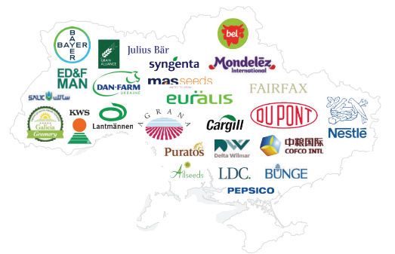
Focus on Economic Growth
In September 2018, Bayer of Germany opened a $ 200 million seed processing plant in Zhytomyr region.
This investment demonstrates Bayer’s strong commitment to Ukraine.
With more than 25 years of successful history in Ukraine, we have always been a key player in developing the country’s agricultural sector.
Bayer will continue working with farmers in Ukraine and is also planning to export its high-quality corn seeds to EU states.
source: https://ukraineinvest.com

Slide 12
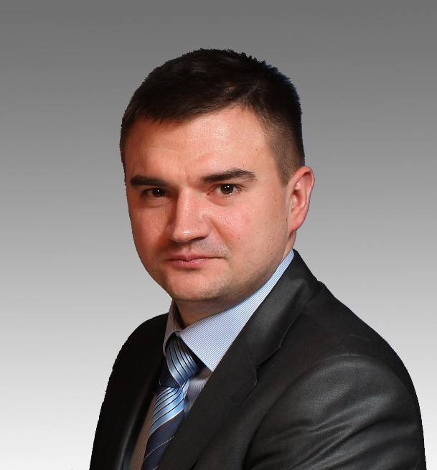
Contact Details
Serhii Kostohryz
Head of Multinational Companies
and Trade Finance Servicing Division
Raiffeisen Bank Aval 7, Pyrohova str., Kyiv, 01030, Ukraine
tel: +380 44 495 41 00
e-mail: Sergey.Kostogryz@aval.ua
THANK YOU!

